Slide 1






What is DSC NUS?

Slide 2

DSC NUS is made up of people from diverse backgrounds.
We come together to push our mission and impact communities.
#TechforGood
Your picture / digital assets here
Who are we

Slide 3
Upcoming Events

Slide 4

Data Analytics
A DSC Tech Workshop Series
(look out for our Insta for latest updates!)

Slide 5

DSC NUS Hack for Good
(more announcement soon!)
Notes:
Hack For Good, a student-run hackathon which seeks to inspire students to learn and use technology for social causes.

Slide 6


Web Dev Workshop
Speakers:
Andre
Jun Hup
Kyler
En Hao
Notes:
First Slide

Slide 7
Brief Overview + Setup
Notes:
Transition Slide

Slide 8
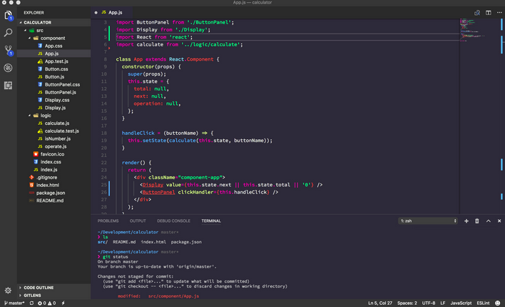
Workshop pre-installation
Ensure you have vscode installed
Notes:
One Paragraph

Slide 9
Workshop pre-installation
Ensure you have downloaded course materials @ https://drive.google.com/drive/folders/1LxAU9LYA5HNMP6X0mNI8GS9TYNwbEfud
Notes:
One Paragraph

Slide 10

Workshop pre-installation
Ensure you have a Github account
Ensure you have downloaded Git Bash
https://git-scm.com/downloads
Notes:
One Paragraph

Slide 11

Workshop pre-installation
Ensure you installed NodeJS
https://nodejs.org/en/download/current/
Notes:
One Paragraph

Slide 12

Overview

Slide 13
What is HTML?
HTML stands for Hyper Text Markup Language
HTML is the standard language for web pages
HTML elements are the building blocks of web pages
They are represented by <> tags

Slide 14
What is CSS?
CSS stands for Cascading Style Sheets
CSS describes how HTML elements are to be displayed on screen, paper, or in other media
It gives a way to modify and style web pages
https://www.w3schools.com/css/css_intro.asp

Slide 15


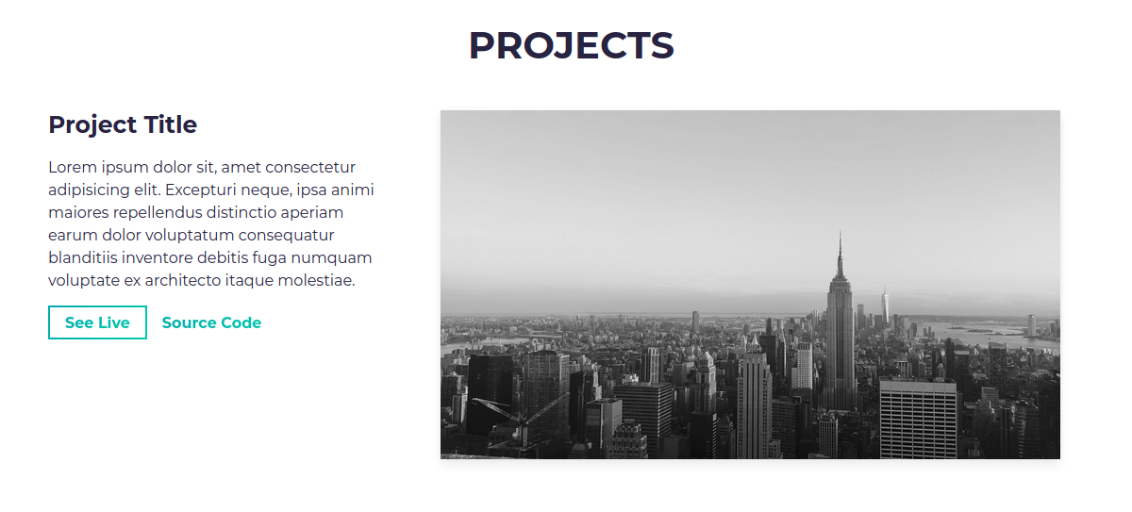
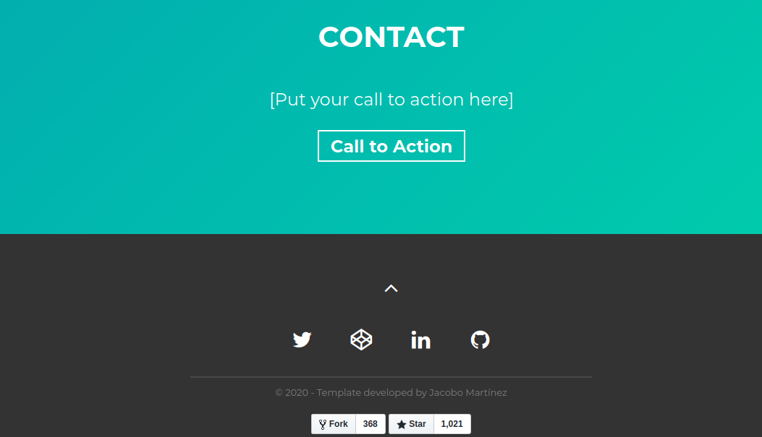
Overview

Slide 16
Running local website
NPM is installed along NodeJS
To install packages, run:
npm install
To run website, run:
npm run

Slide 17
PortFolio Project
(Part 1)
Notes:
Start of Part 1

Slide 18
Additional resources
https://www.w3schools.com/
Document object model
https://www.w3schools.com/js/js_htmldom.asp
Flexbox
https://www.w3schools.com/css/css3_flexbox.asp
Meta tags
https://www.w3schools.com/tags/tag_meta.asp

Slide 19
Break
Notes:
After break will be Portfolio part 2

Slide 20
PortFolio Project
(Part 2)
Notes:
Start of Part 1

Slide 21
What will be covered
Basically the rest

Slide 22
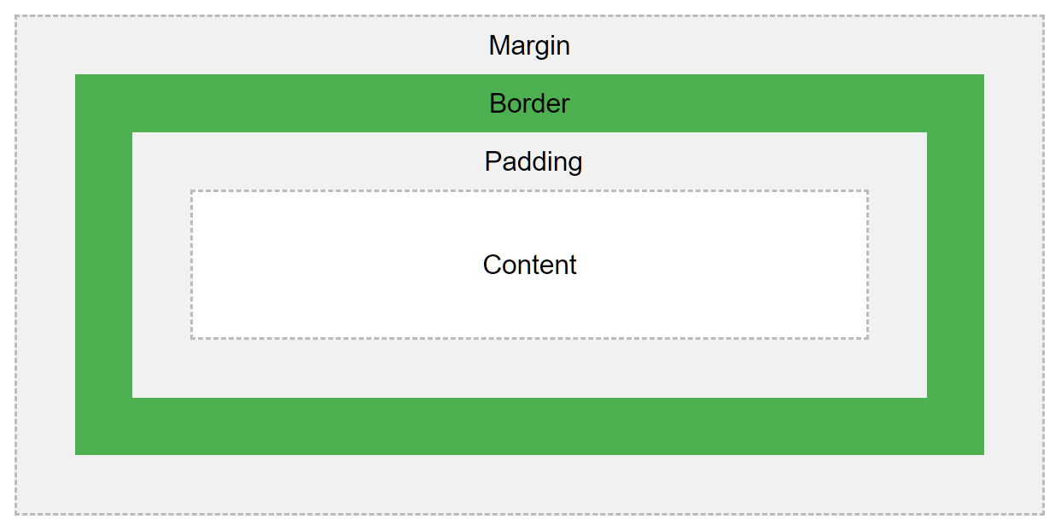
Box Model
Margin
Border
Padding
Content
Height
Width
Notes:
One Paragraph

Slide 23
Deployment (Netlify)

Slide 24
Netlify
Static site hosting service
Able to link to Github
Benefits:
Easy setup
Seamless collaboration using Git and Github
Live updating with normal Github workflow
Cons:
Does not support backend functions (E.g. Databases)
Notes:
https://www.netlify.com/github-pages-vs-netlify/

Slide 25
Pushing Data to Github
Go to https://github.com/
Create a new repository
Upload website files into the git repository using bash (Note: Index.html will be the homepage of your website)
Cd <Insert directory - E.g. C:/Users/abc/Downloads>
Git init
Git remote add origin <Insert github repo link>
Git add .
Git commit -m “Some message”
Git push origin master
Notes:
GitHub Pages is a static site hosting service that takes HTML, CSS, and JavaScript files straight from a repository on GitHub, optionally runs the files through a build process, and publishes a website.
There are three types of GitHub Pages sites: project, user, and organization. Project sites are connected to a specific project hosted on GitHub, such as a JavaScript library or a recipe collection. User and organization sites are connected to a specific GitHub account.
User and organization sites are always published from a repository named <user>.github.io or <organization>.github.io

Slide 26
Deployment using netlify
Go to https://www.netlify.com/
Click “Get Started for Free”
Sign up / Sign In using Github
Under “Sites” tag, click “New Site from Git”
Under Continuous Deployment, Click on “Github” (Next Slide 1)
Select the github that you want to deploy (Next Slide 2)
Edit “build setting” (Next Slide 3)
Deploy (Next Slide 4, 5)
Go to “site settings” and “change site name”(Next Slide 6) (Optional)
Notes:
https://www.netlify.com/github-pages-vs-netlify/

Slide 27
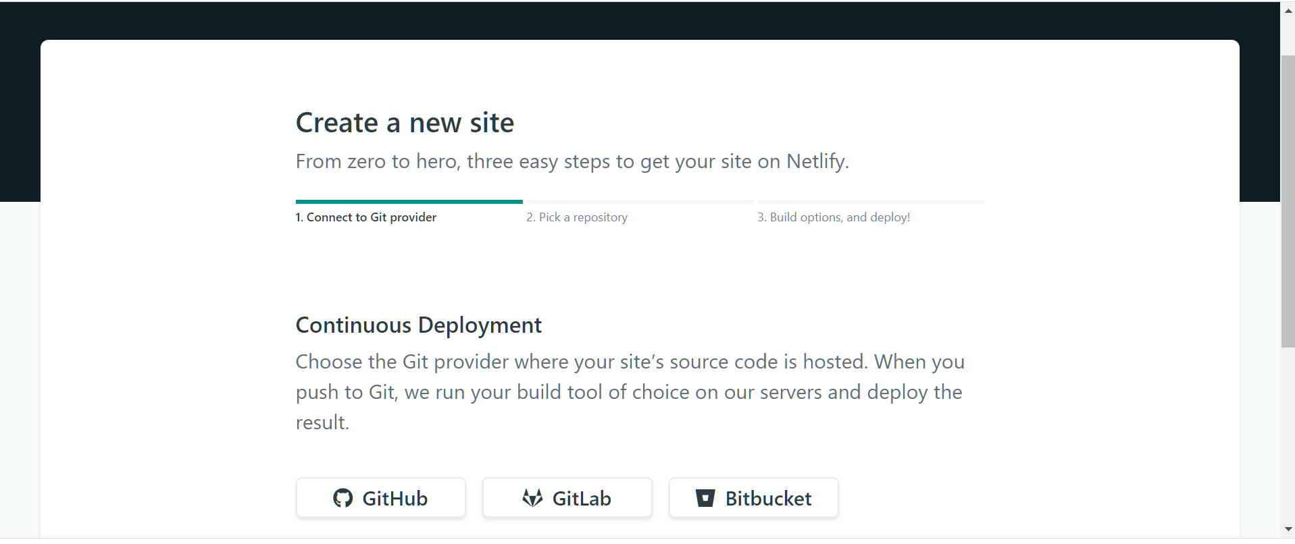
Deployment using netlify
Notes:
https://www.netlify.com/github-pages-vs-netlify/

Slide 28
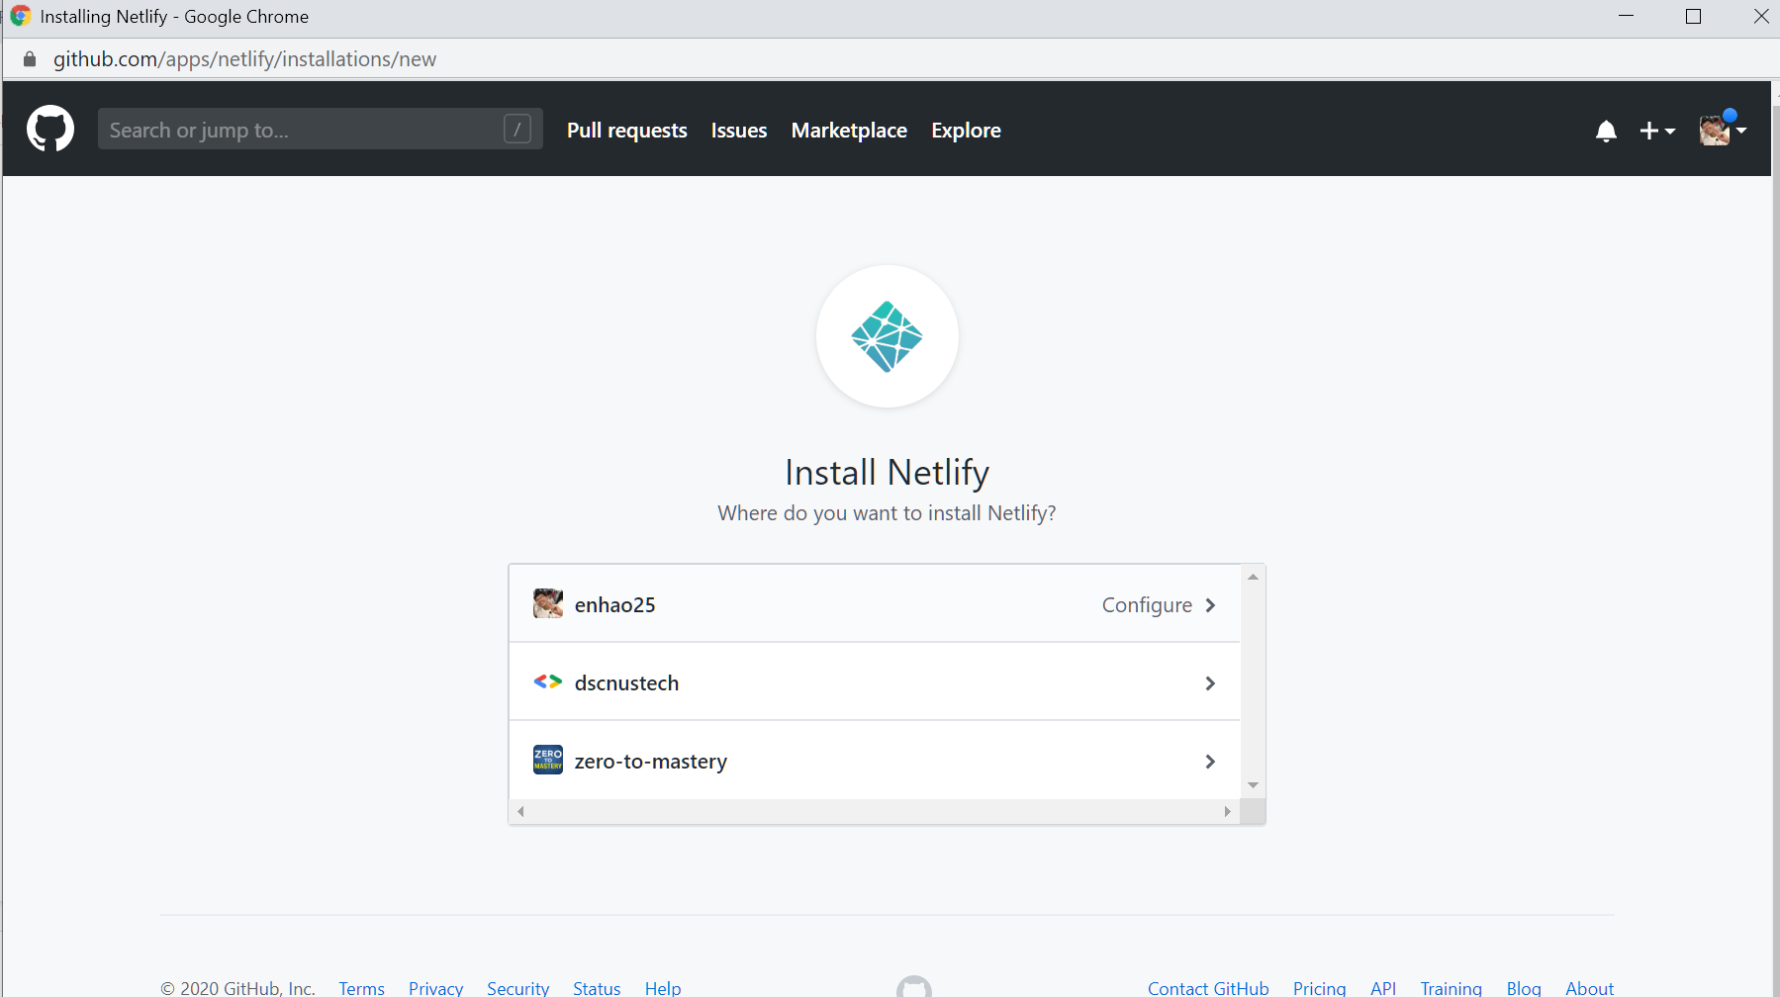
Deployment using netlify
Notes:
https://www.netlify.com/github-pages-vs-netlify/

Slide 29
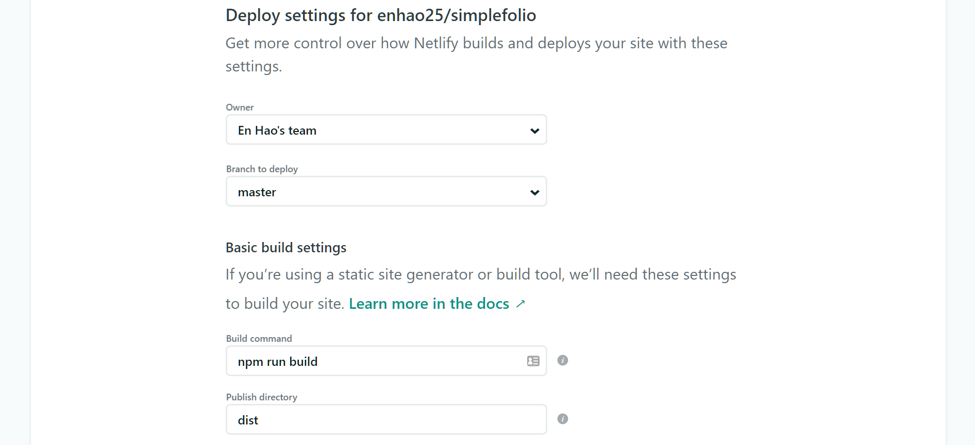
Deployment using netlify
Notes:
https://www.netlify.com/github-pages-vs-netlify/

Slide 30
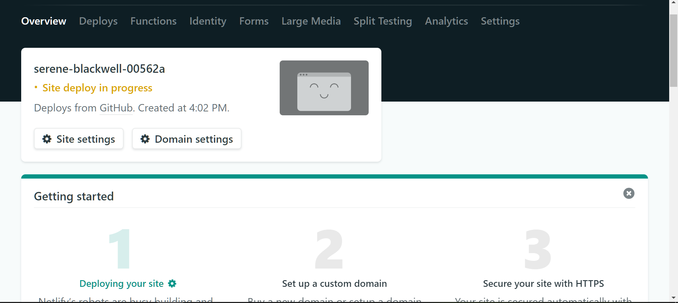
Deployment using netlify
Notes:
https://www.netlify.com/github-pages-vs-netlify/

Slide 31
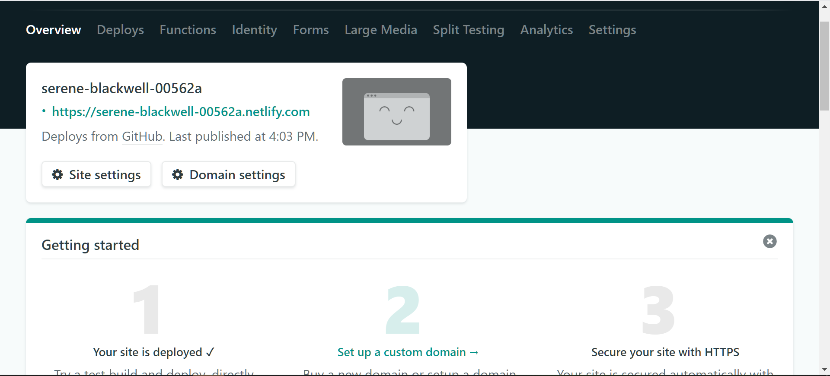
Deployment using netlify
Notes:
https://www.netlify.com/github-pages-vs-netlify/

Slide 32
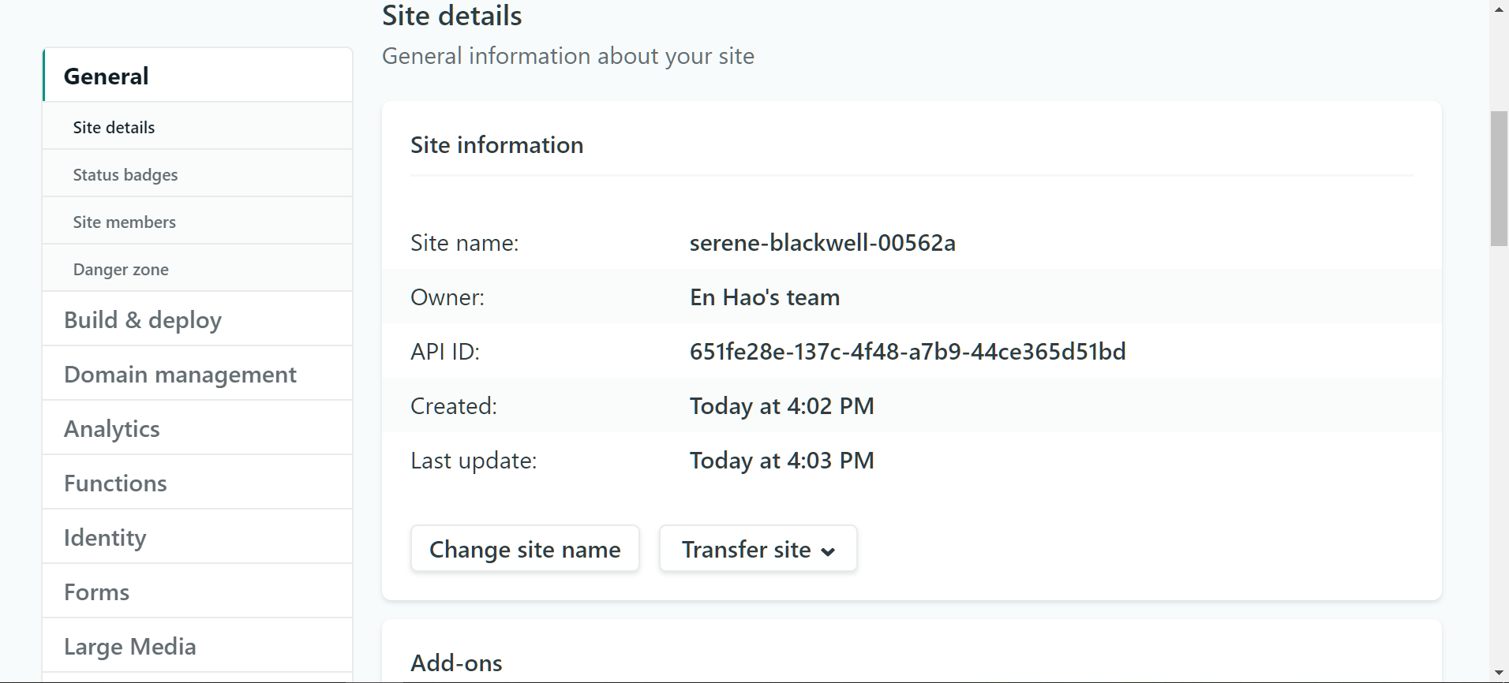
Deployment using netlify
Notes:
https://www.netlify.com/github-pages-vs-netlify/

Slide 33
Review

Slide 34
HTML5 (Hyper Text Markup Language)
The Code every html page must have
<!DOCTYPE html>
<html>
<head>
<title></title>
</head>
<body></body>
</html>
Most tags are required to be closed
Open → Close
<head> → </head>
Notes:
https://www.w3schools.com/tags/tag_doctype.asp

Slide 35
HTML Text Tags
Headings | <h1> to <h5>
Paragraphing words | <p>
Bolding words | <b> or <strong>
Italicising words | <i> or <em>
Insert links | <a href=”” >

Slide 36
HTML List Tags
Ordered lists | <ol>
List tag | <li>
Unordered lists | <ul>

Slide 37
Absolute vs relative paths
This referenced link is relative to where index.html is
<a href=”page2.html”>
Useful for paths that are within the deployment environment
This image link of a cat is an absolute path
<a href=”https://www.google.com/”>
Useful for paths outside of the deployment environment
Relative paths are prefered as during deployment to public websites, absolute file paths may not work

Slide 38
CSS
CSS stands for Cascading Style Sheets
Cascading → From top to bottom
Used to style HTML pages to make it looks nicer (What would happen if a website doesn’t have any CSS?)
Can be linked to HTML page using the <link> tag
E.g. <link rel="stylesheet" type="text/css" href="Your CSS Files">
Favicon: <link rel="icon" type="image/ico" href="favicon.ico">
Notes:
HTML is a way to describe the website, CSS helps to style the webpage. Talks

Slide 39
Defining CSS Styles
<element> { /* CSS Styles */}
E.g. body {text-align: center}
<.class> { /* CSS Styles */}
E.g. .class {text-align: center}
<#id> { /* CSS Styles */}
E.g. #id {text-align: center}
<element / .class / #id>: <action> { /* CSS Styles */}
#input1:focus {background-color: yellow}
.images:hover {height: 200px;}
https://www.w3schools.com/cssref/css_selectors.asp
Notes:
HTML is a way to describe the website, CSS helps to style the webpage. Talks

Slide 40
SCSS
Newer version of CSS
Has all the features of CSS, on top of some additional features
Allows the use of variables
E.g. $color: white
Body{ color: $color }
https://stackoverflow.com/questions/46400443/what-is-the-difference-between-css-and-scss
Notes:
HTML is a way to describe the website, CSS helps to style the webpage. Talks

Slide 41
Common CSS Styles
Text-Align
E.g. Text-Align: Center (Align the text to the center)
Color
Change the font color
E.g. Color: blue / Color: rgb(3, 244, 252) / Color: #03f4fc
https://www.google.com/search?q=color+picker
Font-weight:
Defines the weight of the font (Boldness)
E.g. Font-weight: bold
Font-size
E.g. Font-size: 25px (Fixed pixel) / 2em ( Relative to the font-size of the element) / 2rem (Relative to font-size of the root element)
Notes:
During Color, can use color picker to show how to get # value of colors from websites such as google.com

Slide 42
Common CSS Styles
Font-family
Change the font family style
https://fonts.google.com/
E.g. font-family: 'Great Vibes', cursive;
Display
Specifics how the html is display (E.g. Inline / Block)
https://www.w3schools.com/css/css_display_visibility.asp
Background-color
E.g. background-color: #d3f4ff;
Background-image
Specifics the background image
E.g. background-image: url("bg_img.jpg");
Notes:
Label{ display: block}, for background-color, able to use inspect element to select colors as well
Background-size: cover

Slide 43
Common CSS Styles
Border
Creates a border around the selected element
E.g. border: 2px solid black;
Can use box-shadow to enhance the box design
E.g. box-shadow: 4px 4px 4px 4px grey;
Width
Specific the element Width
E.g. width: 500px;
Height
Specific the element Height
E.g. height: 280px; / height: auto;
Notes:
One Paragraph

Slide 44
FrontEnd
HTML
CSS / SCSS
JavaScript (Will be taught in React Workshop)
Notes:
HTML is a way to describe the website, CSS helps to style the webpage. Talks

Slide 45



Web Hosting
Static Web Hosting (No Database)
Easiest to deploy for simple app
Free Tier (Limited Traffic)
Allows full stack development (Frontend + Backend)
Paid Add Ons for extra Features
Static Web Hosting (No Database)
Free Tier
Paid Add Ons for extra Features
Notes:
HTML is a way to describe the website, CSS helps to style the webpage. Talks

Slide 46
Web Dev Hacks

Slide 47
Google Fonts
Collection of 900+ free-to-use fonts
Includes many unique fonts
Very easy for developers to include in their project
https://fonts.google.com/

Slide 48
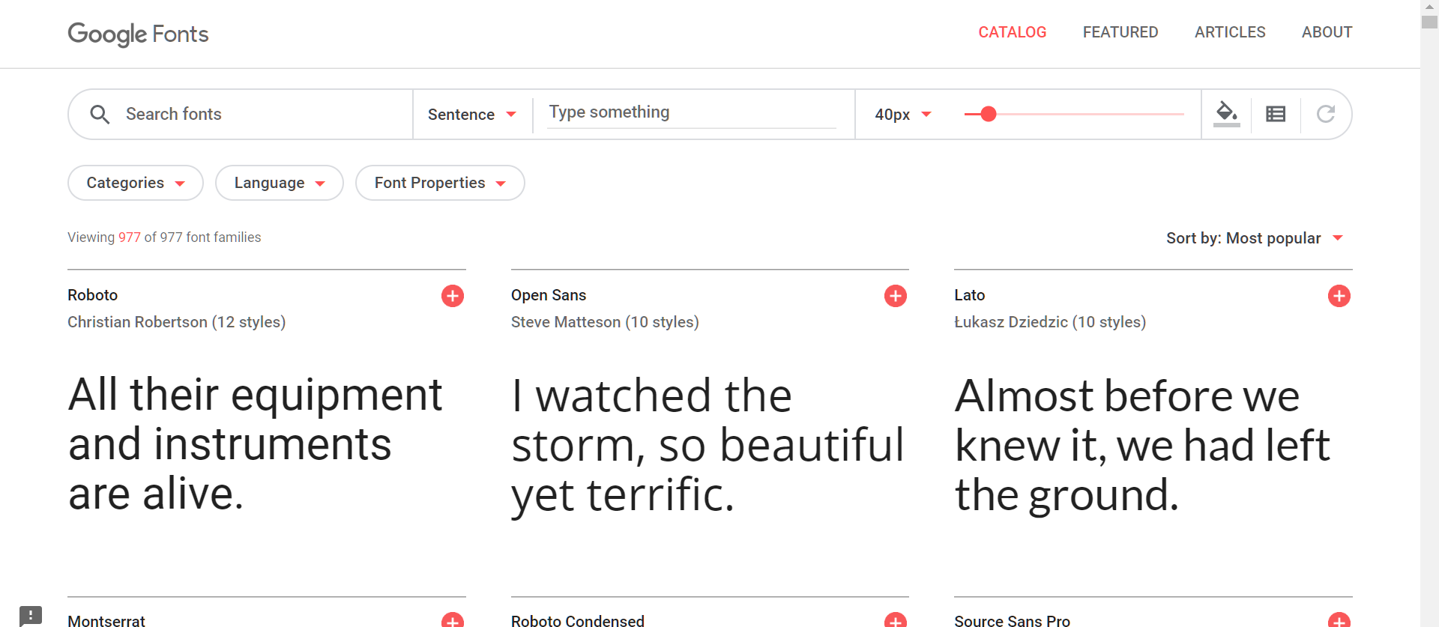
Google Fonts
Step 1: Select your font
Click on the “+” icon to add font
Click in for more details

Slide 49
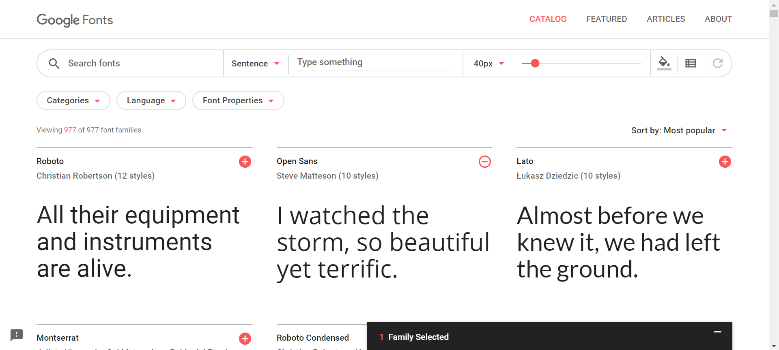
Google Fonts
Step 2: Selecting your font family
This box will appear, click on it

Slide 50
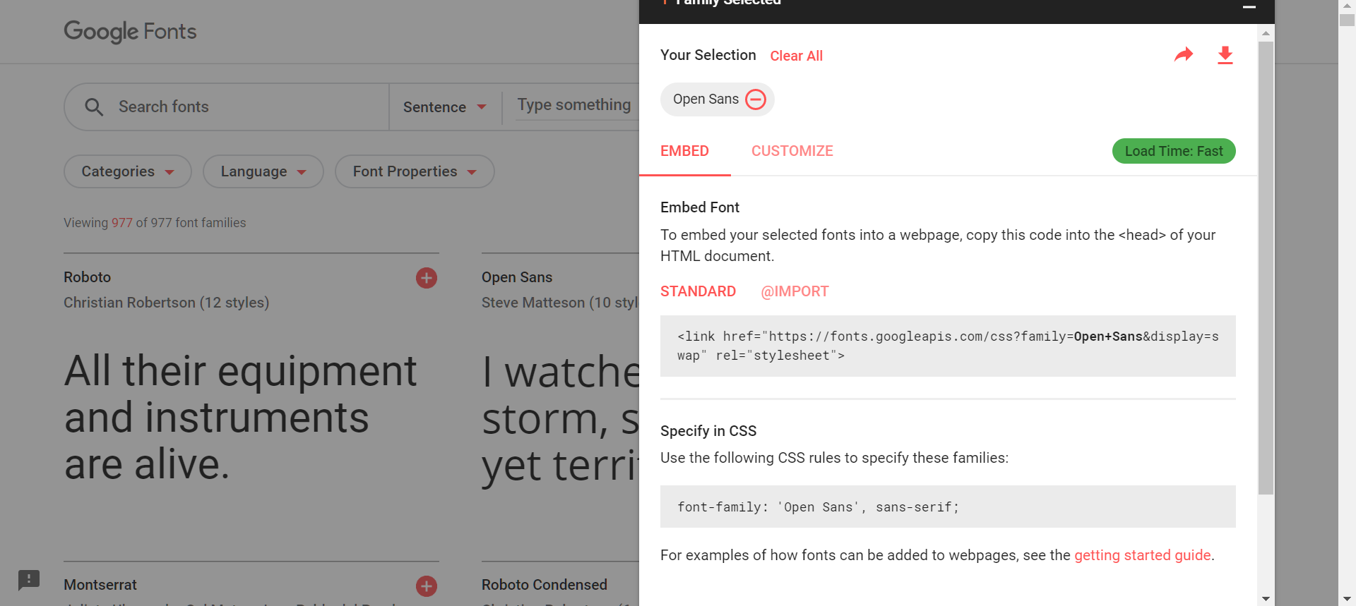
Google Fonts
Step 3: Add to your project
Copy this <link> inside the <head> </head> tag
Copy this to use the font-family

Slide 51




CSS Frameworks
CSS Frameworks are libraries which allows for easier, and standardise web design for CSS
Popular CSS Frameworks:
Bootstrap
Semantic UI
Foundation CSS
Pure CSS

Slide 52
Inspect Element
Way for developer to look at the current state of the website
Commonly used features:
CSS Styles Testing
Mobile View
Console Tab
Color Selector
To Inspect Element:
Right click on webpage
Click on “Inspect” / “Inspect Element”

Slide 53
Colors Selection
Color Palette:
Useful to find corresponding colors that matches
https://color.adobe.com/create
Color Picker:
Google “Color Picker”
Make use of “Inspect Elements” to find existing colors that you like
Background-Gradient
Useful to create more appealing websites through a mixture of colors
https://cssgradient.io/

Slide 54
Additional Info / Resources
Portfolio:
This portfolio was done by cobidev from github, and is in no way owned by DSC NUS
https://github.com/cobidev/simplefolio
https://simplfolio.netlify.com/
HTML / CSS References
https://www.w3schools.com/
Test your HTML / CSS knowledge
https://www.w3schools.com/html/html_quiz.asp
https://www.w3schools.com/css/css_quiz.asp
Notes:
HTML CSS JavaScript and you have made a simple financial calculator on your own! Read up more on the resources that we have provided to you.

Slide 55
Summary

Slide 56
Summary
HTML is a way to describe the website
CSS / SCSS helps to beautify the website
We can make use Frameworks (E.g. Bootstrap) to make our life easier
Free Templates online gives developers a good starting point
Web hosting services allows for free website deployment with limitations (E.g. Github Pages / Netlify / Heroku)
Notes:
HTML CSS JavaScript and you have made a simple financial calculator on your own! Read up more on the resources that we have provided to you.

Slide 57




Thank You!
Please helps us to do the feedback
http://t.me/dscnus
https://www.linkedin.com/company/dscnus/
@dscnus
https://tinyurl.com/rlp8t5r

